Slide 1
Data Analytics in Student Success
DAI Final Capstone
Evelyn Davis
Notes:
Good afternoon everyone, my name is Evelyn Davis, my capstone project is data analytics in student success.

Slide 2
ABOUT ME
Name
Evelyn Davis
Background
Job
Curriculum Developer
Sergeant in the United States Space Force
Trained computer system programmer
Develop curriculum for cyber career field
Degrees in computer science and math
Interests
Travel
Sport
Health
Music
Art
Tech
Notes:
Little bit about me…
As a curriculum developers, It's important to know and understand how to best train our airman.

Slide 3
MOTIVATION
Purpose
AETC mission:
Recruit, train, and educate exceptional Airmen.
Train and Educate in the Air Force:
Student academic performance factors
Behavioral analysis.
Improve training and education.
Notes:
My mission is to support the Air Force Education and Training Command. We are focusing on recruiting, train, and educating exceptional Airmen. What are the factors of the student's academic performance? Is there a relationship between students’ behavioral features? How can we improve our training and education in the department of the Air Force? In this capstone, I will use data virtualization and statistical tools to review some of the key factors affecting students’ success and how to improve our students’ performance in training.
The data is collected using a learner activity tracker tool, which called experience API (xAPI). The xAPI is a component of the training and learning architecture (TLA) that enables to monitor learning progress and learner’s actions like reading an article or watching a training video.
The dataset consists of 480 student records and 16 features. The features are classified into three major categories: Demographic features, Academic background features, and Behavioral features such as raised hand on class, visiting resources, checking announcement view, and participating the discussion groups.
My project focused on the behavioral features since students can improve on those features.

Slide 4
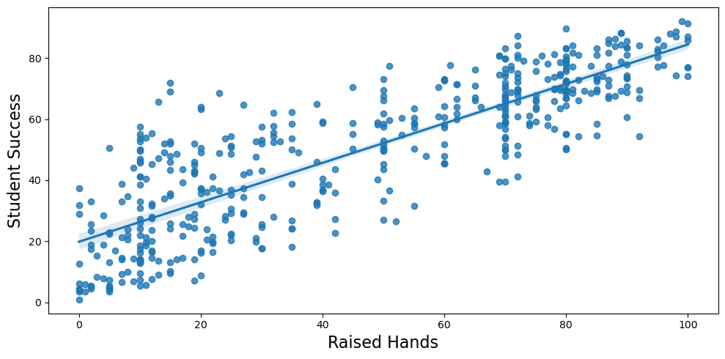
RAISED HANDS
Notes:
First one is raised hands… This column collected how many times the student raised his/her hand during class.
The relationship between the student success and raised hands.

Slide 5
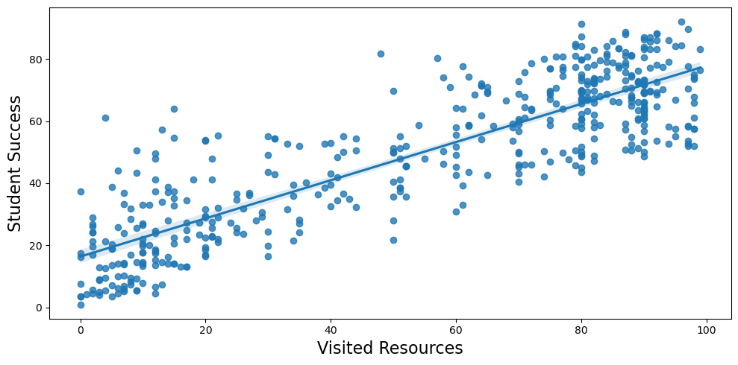
VISITED RESOURCES
Notes:
The second behavior feature is visited resources, this column collected how many times the student visits a course content.

Slide 6
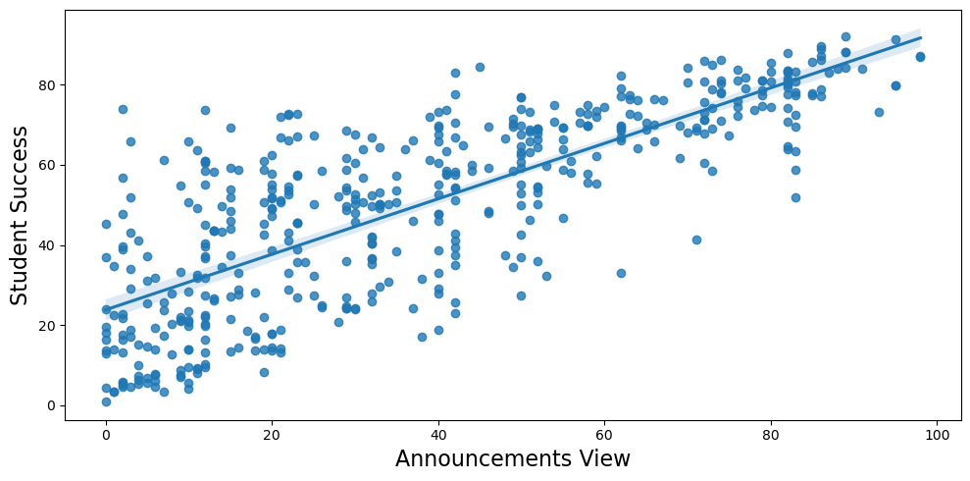
ANNOUNCEMENTS VIEW
Notes:
The third behavior feature is announcements view, this column collected how many times the student checks the new announcements.

Slide 7
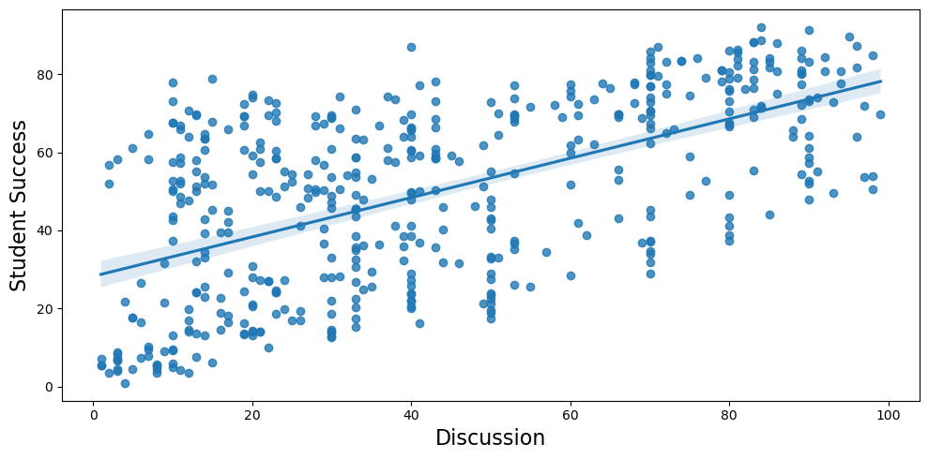
DISCUSSION
Notes:
Finally, the last behavior feature is discussion, this column collected how many times the student participate on discussion groups.

Slide 8
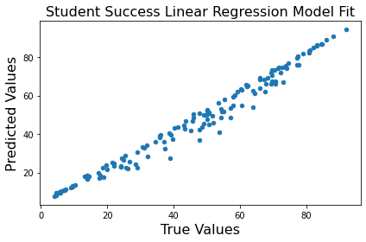
LINEAR REGRESSION
Coef
P-value
Raised Hand
6.638
0.122
Visited Resources
11.212
0.006
Viewed Announcements
4.710
0.233
Raised Hand
Viewed Announcements
Increase 6.638 points
Increased 4.710 points
Visited Resources
Participated Discussion
Participated Discussion
6.683
0.034
Increased 11.212 points
Increased 6.683 points
Notes:
Now we know the relationship between our behavior features and student success variables are linear.
After plotting the heatmap to check the correlation between my variables, there is little or no multicollinearity in the data, also there is no autocorrelation between by data.
After plotting the histogram and scatterplot, all the variables are multivariate normal, and the residuals are mostly equal across the line of regression.
Now we can make a linear regression for my data…

Slide 9
SUMMARY SUGGESTION
Activities
Evaluation
Feedback
Create more group activities
Record and encourage students to visit more course content
Students
Give valuable feedback to students in class
Monitor students’ behaviors progress
Extra point for each time student checks the new announcements
Encourage student engagement in class
Observations
Grades

Slide 10
FUTURE WORK
More data: The original data only has 480 instance and 16 attributes, collecting more data could improve accuracy.
Hypothesis testing: Welch two sample T-test, and Chi-squared test to see if student behaviour differ by demographic features.

Slide 11

CREDITS: This presentation used graphic designs provided by Slidesgo, including icons by Flaticon, and infographics & images by freepik
THANKS
evelyn.davis.1@spaceforce.mil
+1 228-377-0651
/dyan27/dai-capstone

